Slide 1
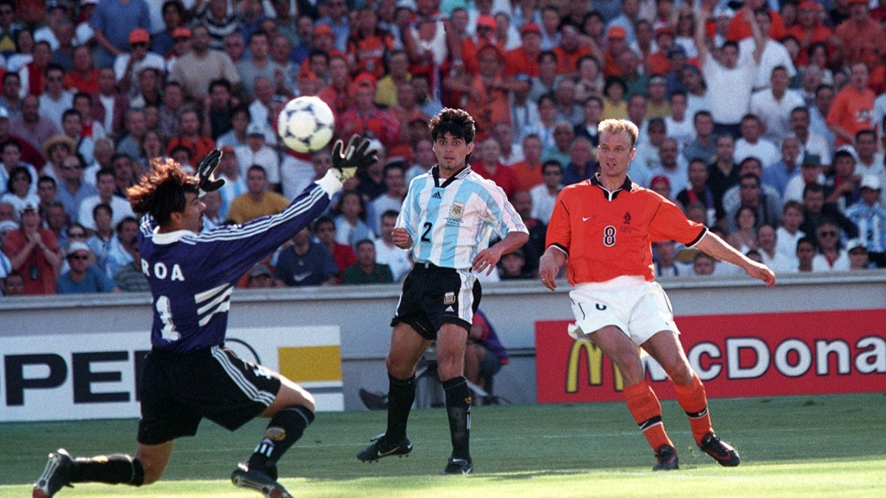

The Physics of Football A scientific insight into the mechanics of curve.
Overview
Why does a football not travel in a straight line?
The governing equations of curve
The Roberto Carlos freekick
The Knuckleball
Football Design

Slide 2
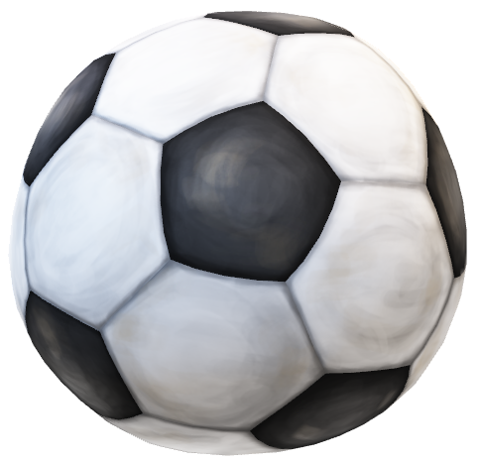
The Physics of Football A scientific insight into the mechanics of curve.
Overview
Why does a football not travel in a straight line?
The governing equations of curve
The Roberto Carlos freekick
The Knuckleball
Football Design
Newtonian Law
An object in motion will stay at constant speed and direction unless acted upon by a force

Slide 3
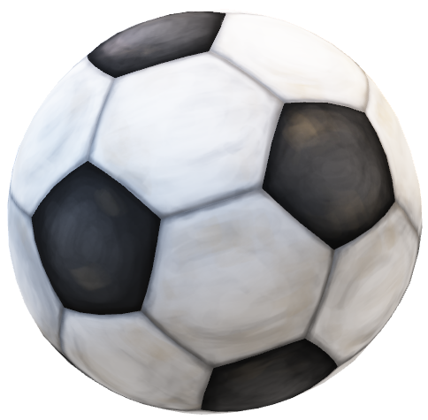

Overview
Why does a football not travel in a straight line?
The governing equations of curve
The Roberto Carlos freekick
The Knuckleball
Football Design
Newtonian Law
An object in motion will stay at constant speed and direction unless acted upon by a force

Slide 4
Overview
Why does a football not travel in a straight line?
The governing equations of curve
The Roberto Carlos freekick
The Knuckleball
Football Design
Newtonian Law
An object in motion will stay at constant speed and direction unless acted upon by a force

Slide 5


Overview
Why does a football not travel in a straight line?
The governing equations of curve
The Roberto Carlos freekick
The Knuckleball
Football Design
THRUST
Newtonian Law
An object in motion will stay at constant speed and direction unless acted upon by a force
GRAVITY
DRAG

Slide 6
Overview
Why does a football not travel in a straight line?
The governing equations of curve
The Roberto Carlos freekick
The Knuckleball
Football Design
Newtonian Law
An object in motion will stay at constant speed and direction unless acted upon by a force

Slide 7
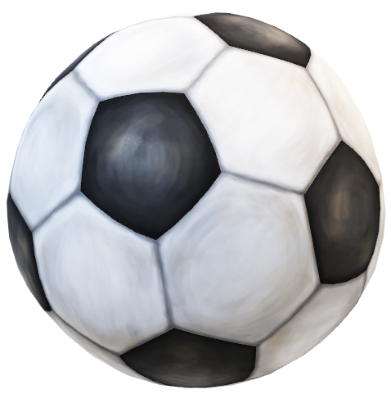
Overview
Why does a football not travel in a straight line?
The governing equations of curve
The Roberto Carlos freekick
The Knuckleball
Football Design
Newtonian Law
An object in motion will stay at constant speed and direction unless acted upon by a force

Slide 8
Overview
Why does a football not travel in a straight line?
The governing equations of curve
The Roberto Carlos freekick
The Knuckleball
Football Design
THRUST
Newtonian Law
An object in motion will stay at constant speed and direction unless acted upon by a force
GRAVITY
DRAG

Slide 9
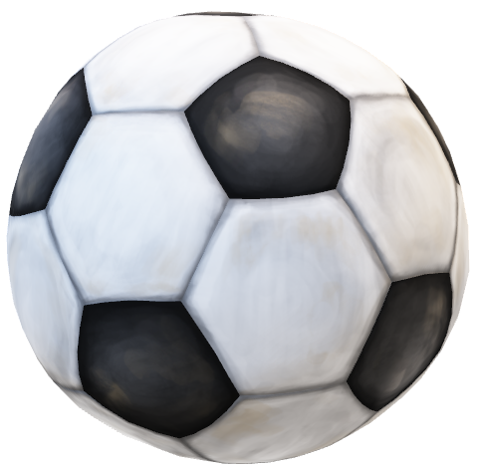
Overview
Why does a football not travel in a straight line?
The governing equations of curve
The Roberto Carlos freekick
The Knuckleball
Football Design
THRUST
Newtonian Law
An object in motion will stay at constant speed and direction unless acted upon by a force
GRAVITY
MAGNUS EFFECT
DRAG

Slide 10
Overview
Why does a football not travel in a straight line?
The governing equations of curve
The Roberto Carlos freekick
The Knuckleball
Football Design
THRUST
Newtonian Law
An object in motion will stay at constant speed and direction unless acted upon by a force
GRAVITY
The force that causes the ball to move sideways is attributed to the Magnus Effect
The Magnus Effect occurs when the ball has spin
MAGNUS EFFECT
DRAG

Slide 11
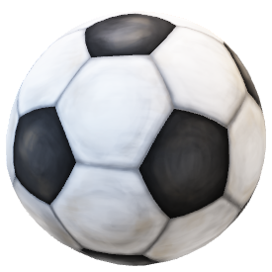
Overview
Why does a football not travel in a straight line?
The governing equations of curve
The Roberto Carlos freekick
The Knuckleball
Football Design
Newtonian Law
An object in motion will stay at constant speed and direction unless acted upon by a force
The force that causes the ball to move sideways is attributed to the Magnus Effect
The Magnus Effect occurs when the ball has spin

Slide 12

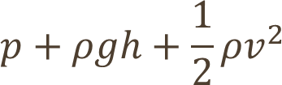
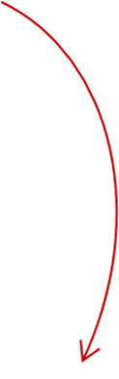
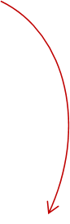
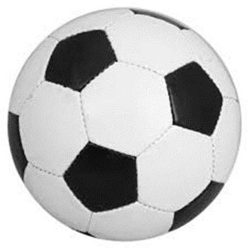




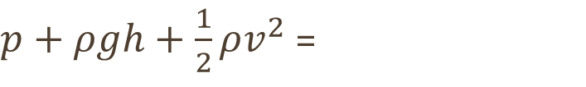
Explanation
The Bernoulli Equation:
The movement of particles create high and low pressure zones either side of the ball
The curling of the ball towards the low pressure zone is the Magnus Effect
$p+ρgh+\frac{1}{2}ρv^{2}$ =
GRAVITY
low
HIGH
HIGH
low
HIGH velocity
low pressure
low velocity
HIGH pressure

Slide 13
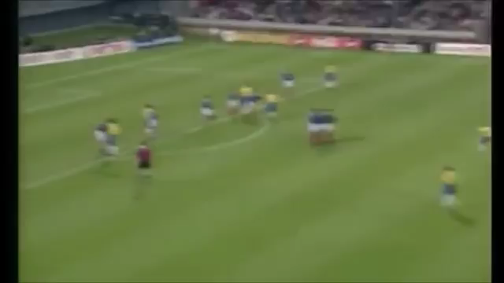

Slide 14
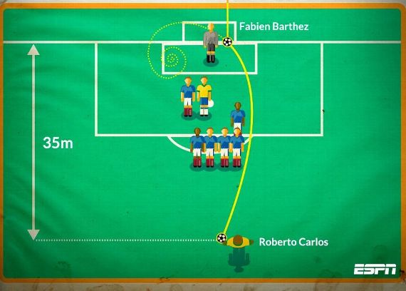
Analysis
The first 20m-25m:
High Velocity
Higher Reynolds Number
Turbulent Flow
Later Boundary Separation
Lower Pressure Drag due to Narrow Wake
Low Magnus Effect
The last 10m-15m:
Decrease in Velocity
Lower Reynolds Number
Laminar Flow (Drag Crisis)
Earlier Boundary Separation
Increased Pressure Drag
Increased Magnus Effect

Slide 15
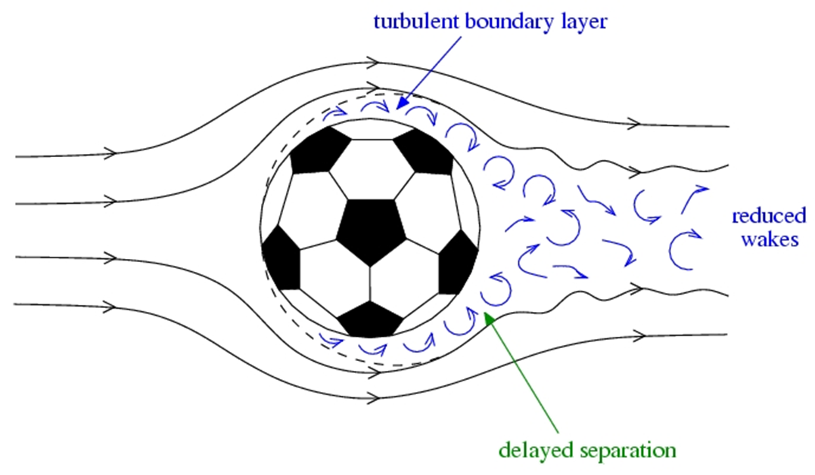

Slide 16
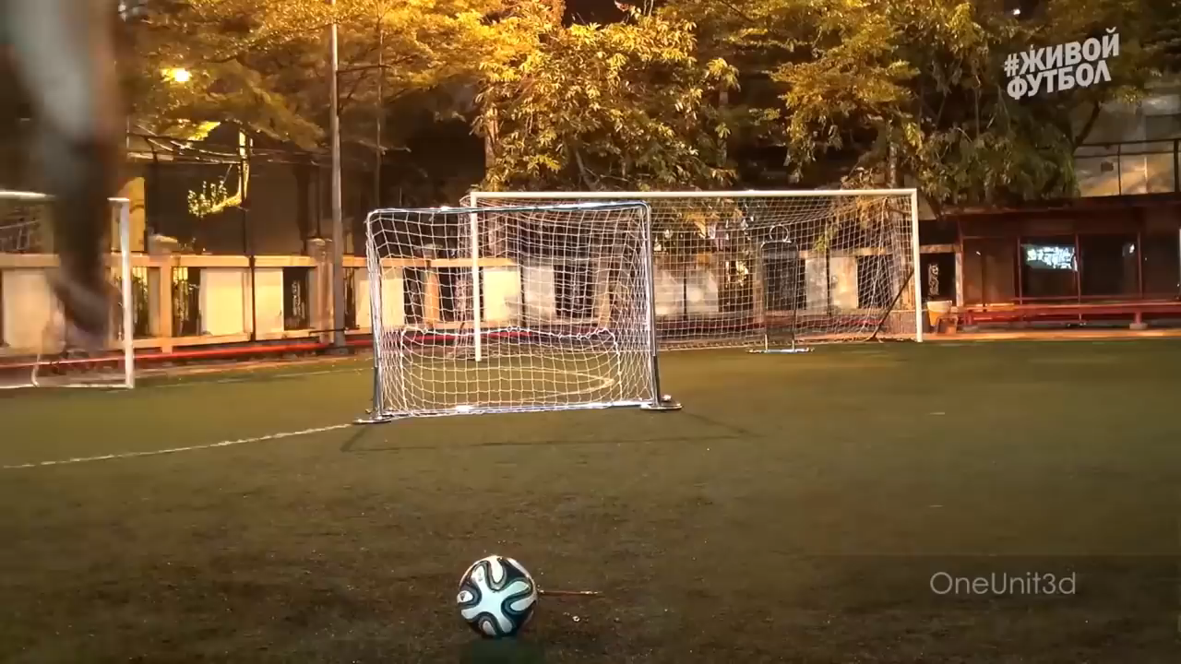

Slide 17

Knuckleball Explained
Caused by intermittent variations in airflow and pressure either side of the ball.
Stitch Theory: The stitches of a ball affect the airflow around the ball differently to the smooth panels, causing random airflow as it spins slowly and therefor turbulence. The Jabulani opposes this.
Boundary Layer Theory: The boundary layers can attach and re-attach randomly, giving turbulent and laminar flows either side at different times.

Slide 18
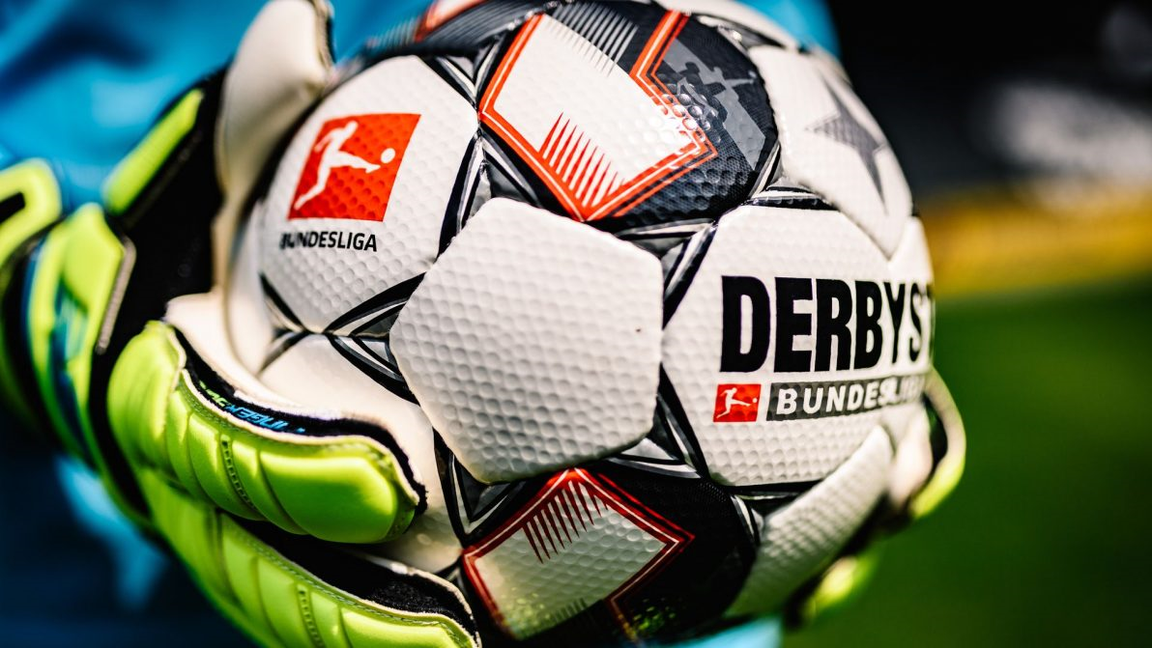
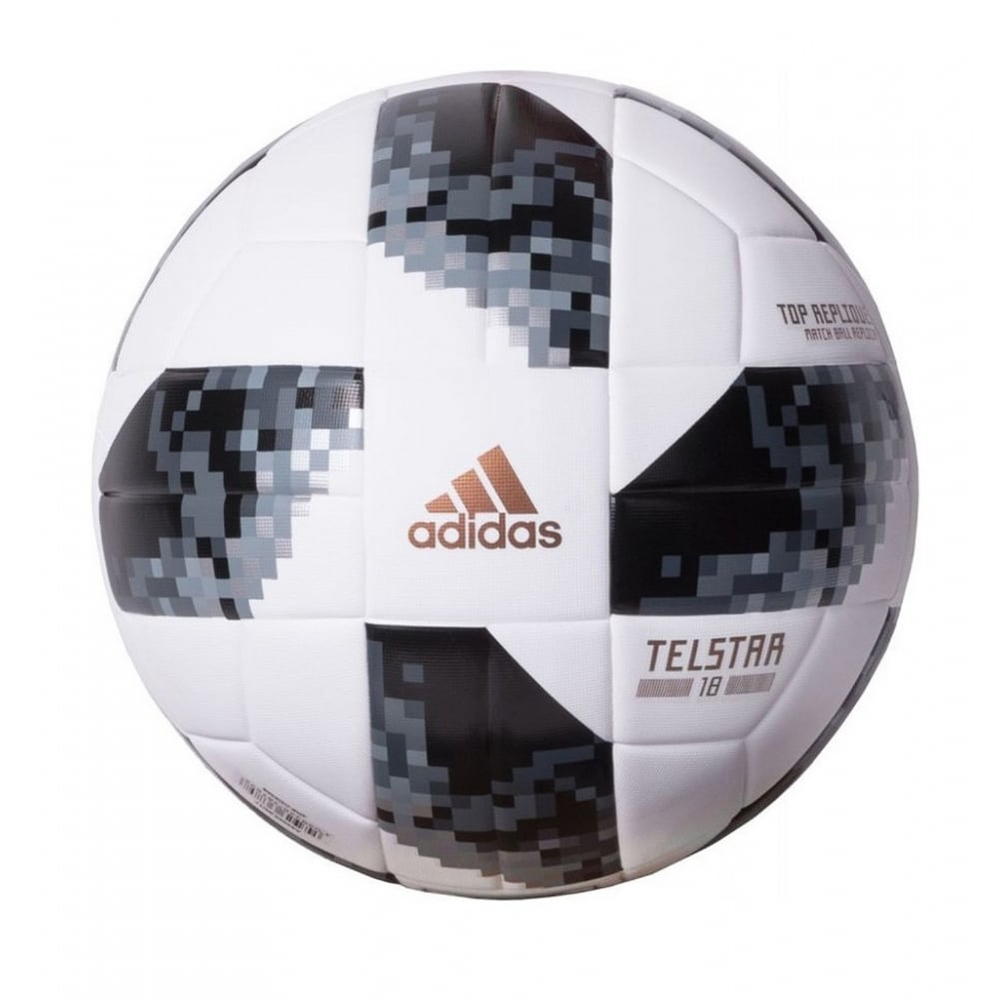
Design of a Football
Must be…
28-30cm wide
58-62cm in circumference
410-460g in mass
65.7–68.8 kPa in pressure
Professional vs Replica
Lighter, more responsive material
Glued not Stitched
Rough Surface
A rough surface means the boundary layer separates later, causing a smaller turbulent wake and therefore less drag. The Pro ball moves faster, further and reaches its drag crisis sooner with less variation in the drag coefficient for a truer flight.

Slide 19
